Slide 1

Advanced Machine Learning Techniques for Heart Disease Prediction

Slide 2
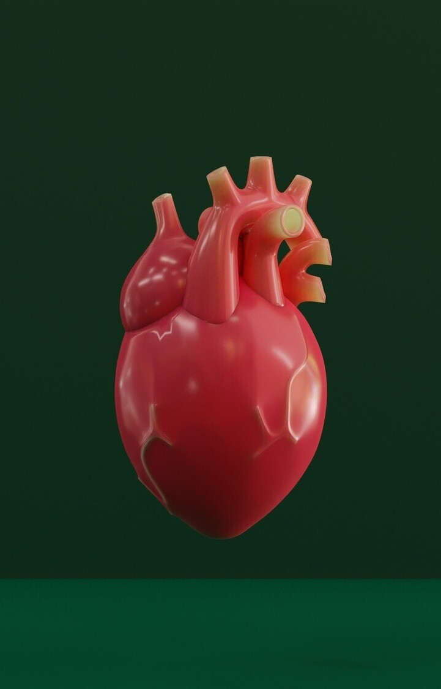
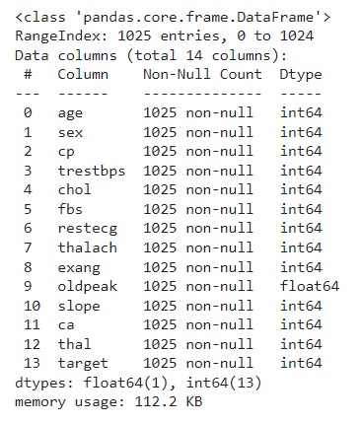
Info of the dataset

Slide 3


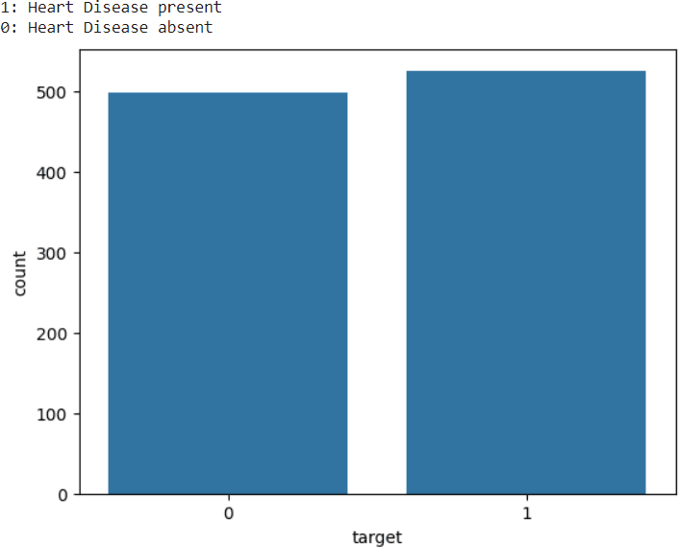
Introduction
In this presentation, we will e plore advanced machine learning techniques for heart disease prediction. We will delve into the latest research and methodologies to improve accuracy and early detection.
This represents the count of people those have heart disease and those who dont have. 1 represents patient has heart disease and 0 represents patient does not have heart disease

Slide 4

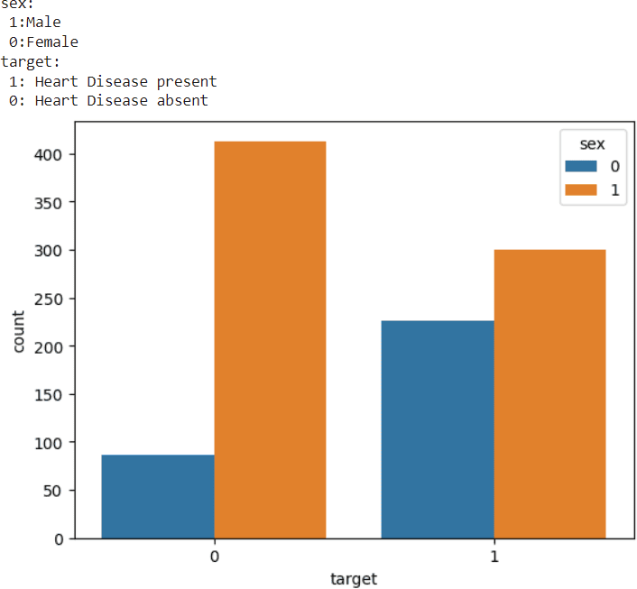
For target = 0 (heart disease absent), the count of
males (orange bar) is signiﬁcantly higher than the count of females (blue bar).
For target = 1 (heart disease present), the count of males (orange bar) is also higher than the count
of females (blue bar), but the diIerence is less pronounced compared to target = 0.
In both categories (heart disease present and
absent), males have higher counts than females.
For target = 0 (heart disease absent), the count of males (orange bar) is signiﬁcantly higher than the count of females (blue bar).
For target = 1 (heart disease present), the count of males (orange bar) is also higher than the count of females (blue bar), but the diIerence is less pronounced compared to target = 0.In both categories (heart disease present and absent), males have higher counts than females.
Analysis of the data

Slide 5

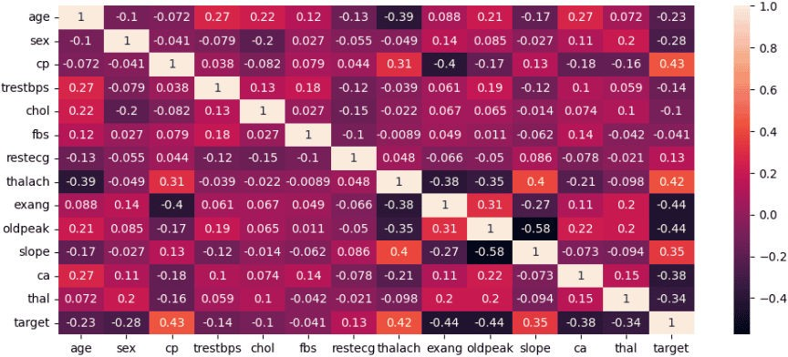
Correlation heatmap of the attributes
Heatmap of correlation between the attributes of the dataset. Those attribute which correlate highly with the target are considered to be the best for analysis and prediction and those which correlate highly among themselves those are not good features hence not taken for analysis and prediction.

Slide 6

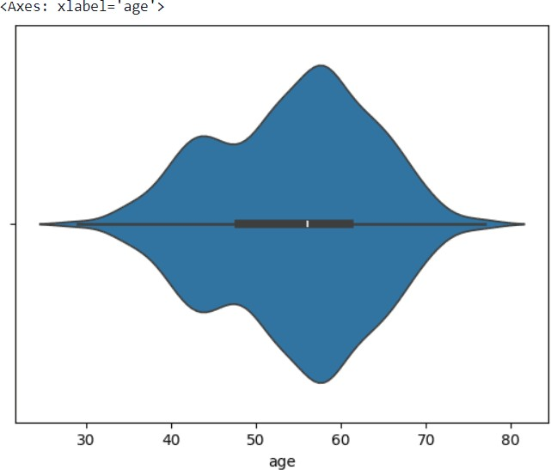

Violinplot of the age
The above ﬁgure represents the violinplot for the feature age of people. The ma imum age according to this is above 80 years, minimum age is below 30 years. The median age is between 55 to 60 years. Lower quartile is between 45 to 50 years and 3rd quartile is around 60 to 65.

Slide 7


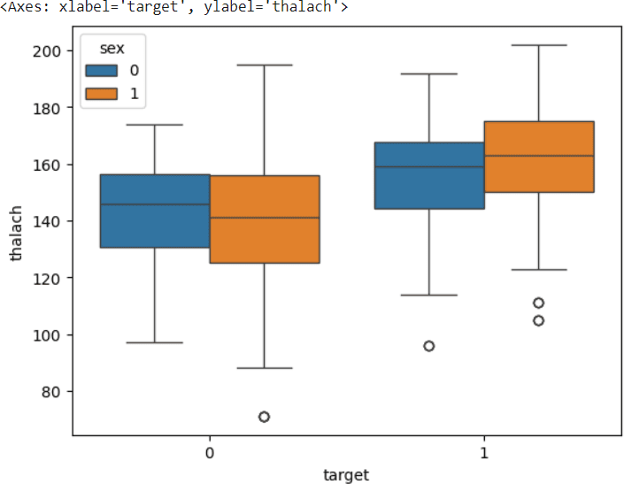

Bo plot of thalach and target
In this speciﬁc bo plot, the -a is is labeled "target" and the y-a is is labeled "thalach". "Thalach" likely refers to thalachassemia, a blood disorder that can cause anemia. It is possible that the target variable is some kind of medical intervention or treatment. The bo in the center of the plot contains the middle 50% of the data. The line in the middle of the bo is the median, which is the value that separates the lower half of the data from the upper half. The whiskers e tend from the edges of the bo to the highest and lowest values within 1.5 times the interquartile range (IQR) from the quartile. The IQR is the diIerence between the third quartile (Q3) and the ﬁrst quartile (Q1). Any data points beyond the whiskers are considered outliers and are plotted as individual points.

Slide 8

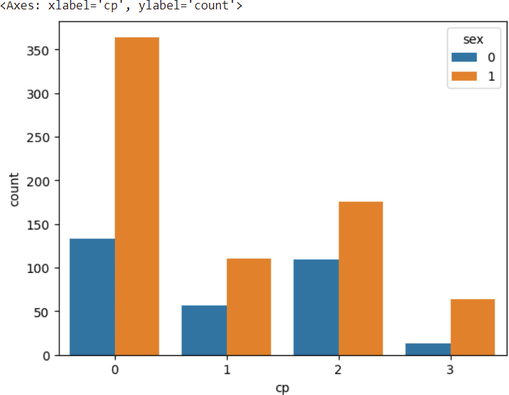

Barplot of the count of male and female with respect to thalach
It shows the number of people who have been married in the past year, broken down by se . The y-a is label shows the count of with respect to gender. The title of the graph is missing. 2. The -a is label is "cp". 3. It likely refers to a categorical variable, but the meaning is not provided in the graph. 4. The y-a is label is missing. 5. There are two bars in the graph. 6. The taller bar is labeled "1" on the -a is corresponds to male.

Slide 9
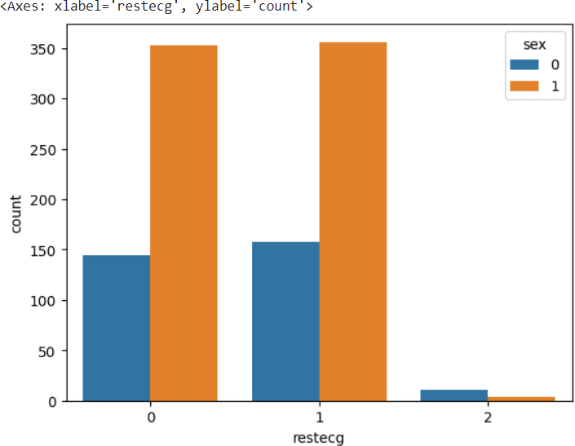
Barplot of the count of male and female with respect to restecg
Bar graph that shows the number of people by se . The - a is label is ‘restecg’ and the y-a is label is ‘count’. It appears to be related to a medical dataset. The blue bar represents the number of people with a value of ‘0’ for the restecg variable. The orange bar represents the number of people with a value of ‘1’ for the restecg variable.

Slide 10

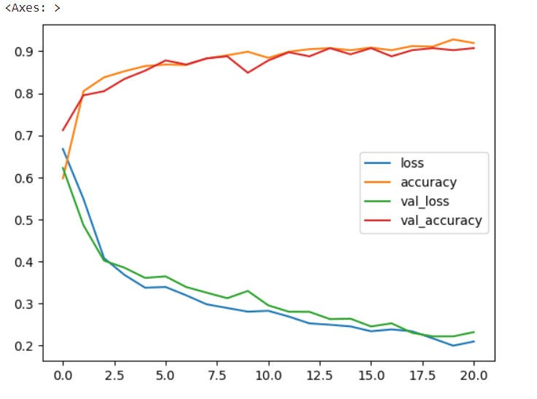


Model Evaluation
The above ﬁgure or graph represents the loss, accuracy, val_loss, val_accuracy with repect to number of epochs. a is represents the number of epochs, and Y a is represents the value of these parameters speciﬁed in the legend.

Slide 11

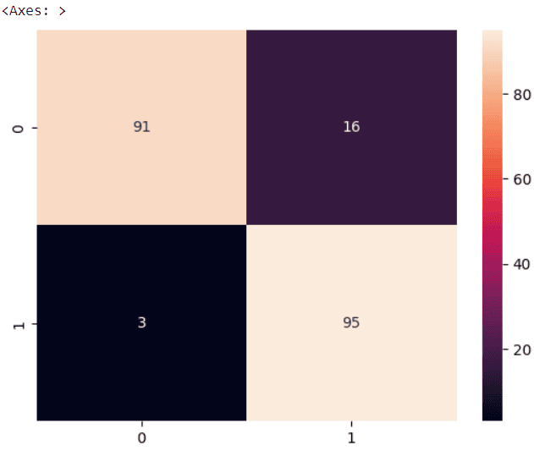

Metrics
Confusion matrices are used in machine learning to evaluate the performance of a classiﬁcation model. They are a table that shows the number of times that the model classiﬁed instances into each class. Each row of the matri represents the instances in an actual class, and each column represents the instances in a predicted class.Here’s a breakdown of the information the aes and labels in the image provide:
The y-a is represents the actual values. The -a is represents the predicted values.
The numbers along the aes, like “3” and “95” could represent class labels.

Slide 12

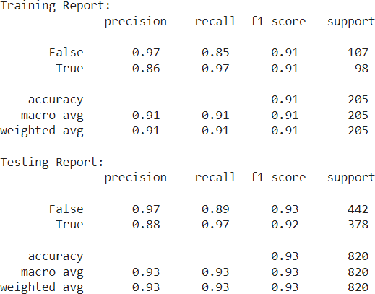
Interpreting Model Results
Classiﬁcation report of the Heart disease prediction model

Slide 13
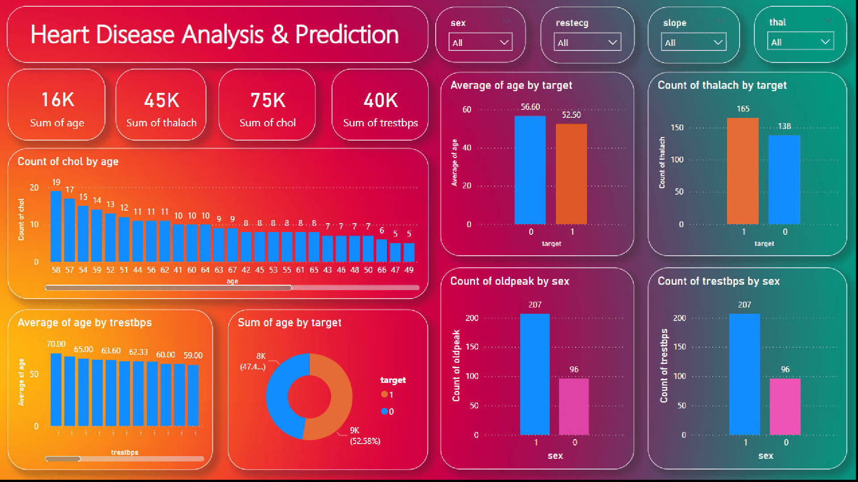

Slide 14


Some Points related to the dashboard
Summary Statistics: The top section displays the total sums for key metrics: age (16K), thalach (ma imum heart rate, 45K), chol (cholesterol, 75K), and trestbps (resting blood pressure, 40K).
Cholesterol by Age: A bar chart shows the distribution of cholesterol levels (chol) across diIerent age groups, highlighting how cholesterol counts vary with age.
Average Age by Heart Disease Target: A bar chart compares the average age of individuals with heart disease (target = 1) and those without it (target = 0), showing that the average age is slightly higher for those without heart disease.
Thalach by Heart Disease Target: This bar chart compares the count of ma imum heart rates achieved (thalach) for individuals with and without heart disease, indicating higher counts for those with heart disease.
Average Age by Resting Blood Pressure: A bar chart illustrates the average age of individuals across diIerent resting blood pressure (trestbps) levels.
Sum of Age by Heart Disease Target: A pie chart shows the distribution of the total sum of ages by heart disease target, with nearly equal proportions for those with and without heart disease.
Metrics by Se : Bar charts present counts of oldpeak (e ercise-induced ST depression) and trestbps by se , highlighting gender diIerences in these metrics. Interactive ﬁlters for se , resting ECG results, slope of peak e ercise ST segment, and thalassemia status allow for more detailed data analysis.

Slide 15

Case Studies
We will examine real-world case studies where advanced machine learning techniques have been applied for heart disease prediction. These examples will provide insights into the practical application and impact on patient care.

Slide 16
Conclusion
In conclusion, advanced machine learning techniques offer immense potential for accurate heart disease prediction. By leveraging the latest methodologies and advancements, we can signiﬁcantly improve early detection and patient outcomes.

Slide 17
Thanks!
Do you have any questions? suyashpandey9611@gmail.com 7905174871

